Slide 1
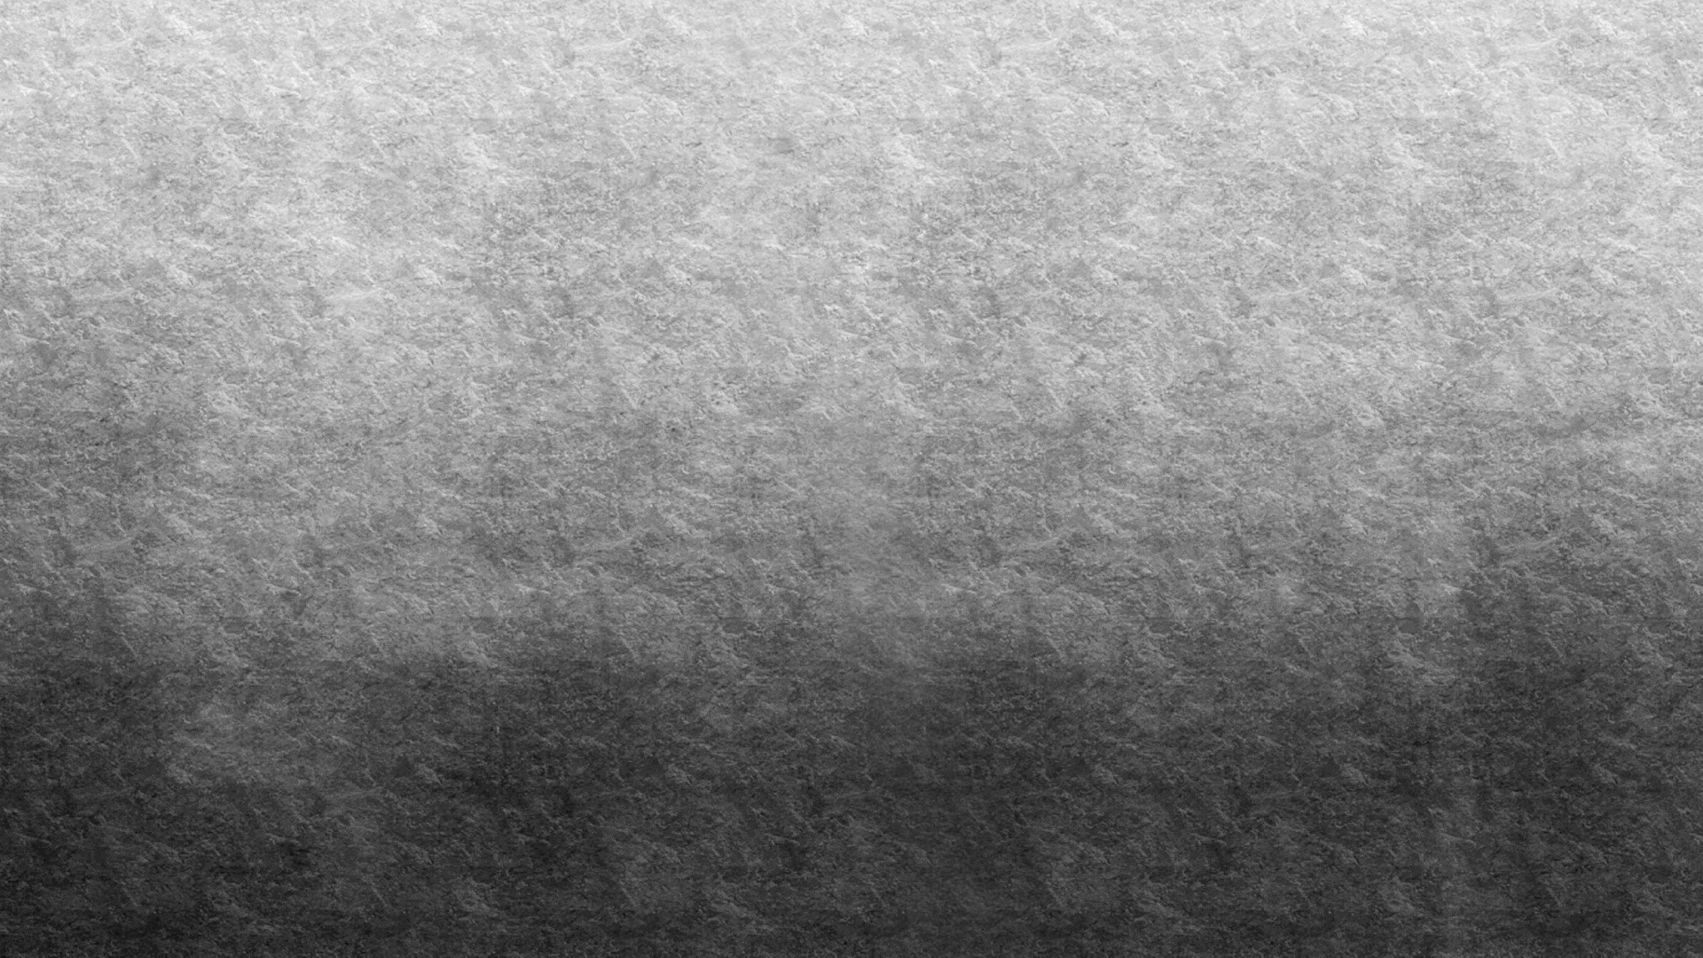

Theft Detection: Shoplifting.
By : Ben Haj Yahia AHMED

Slide 2

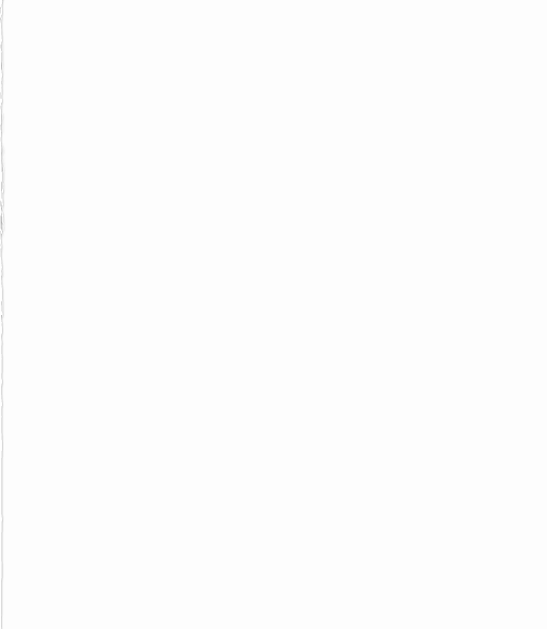
Contents
1. Model
2. Data
3. Output
4. Model performance
5. Steps to use the model

Slide 3
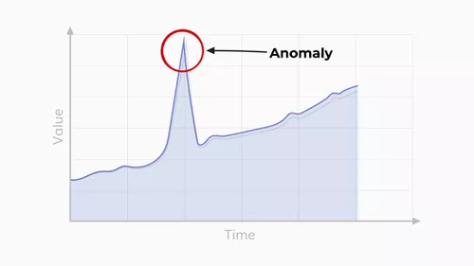
1. Model: General idea
Anomaly detection : An anomaly is an event that betrays pre-defined patterns
Given a video, find if there is an “anomaly” by finding parts of video that deviates from normal pattern.
Goal:
Find Function F such that:

Slide 4
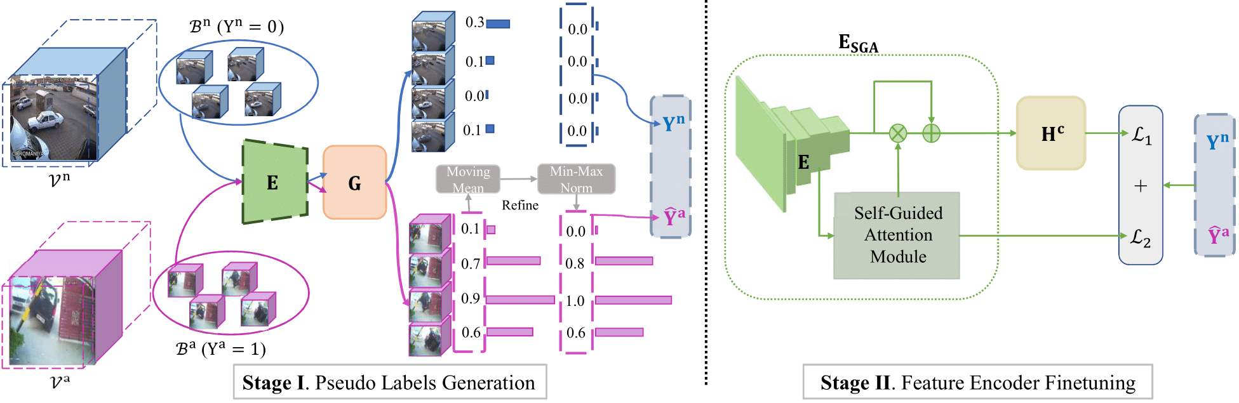
1. Model: Architecture
Stage 1:
Extract features by a pre-trained feature encoder (E) (C3D sport1M)
Use Sparse Continuous Sampling to generate (G) Anomaly scores.
(SCS: Set of bags. Each bag contains similar anomaly videos. Each bag will find “normal” pattern and compare it with other bags’ “normal’ patterns. Until they find generalized “Normal” pattern. They then assign values to how much the frame deviates from that pattern.
3. Those values are then processed to be get refined pseudo labels.
Stage 2:
Train a Feature Encoder with Attention mechanism.
Notes:
Stage 1, first extract features by a pre-trained feature encoder (E) (C3D sport1M: a model that is trained on more than 1M sports videos. The goal here is to use a model that is already familiar with Persons, Background, Videos..etc) Of course here, we do not use the classification part of it, but we use all what is done before the classification part. That is why we call it Feature extraction.)
Then Use sparse continuous sampling to train a pseudo label generator.
(Sparse continuous sampling: Think of multiple bags, and in each bag, there is a set of multiple videos containing similar anomaly event (for example one bag shoplifting, another bag Arrest, another bag Assault ..etc ). This method will find similar patterns in the videos in the same bag and the videos of the other bags, So we will have like a generalization of the “normal” patterns. This will then help each bag to be able to generate an anomalous score for each frame in the videos of its bag.
The resulting anomalous scores are then refined by moving average and Min Max normalization (these two mathematical methods lead us to better choice of labels (or pseudo labels)
Once we have the frame-by-frame anomalous scores, (pseudo labels) we train a feature encoder with attention mechanism (So its like a memory , the model will learn that it is not dealing with image by image, but is dealing with a succession of related frames). This will result in scores of belonging to a specific label/anomaly

Slide 5
2. Data
UCF Crime dataset. CRCV | Center for Research in Computer Vision at the University of Central Florida (ucf.edu).
The link contains a detailed description of what is contained and how to use the dataset.
Multiple videos of 12 kind of anomalies are presented. There is also a set of Normal videos that are used both in pseudo labeling and in last step, to both assess the model and to train it with no anomalies.
A second dataset ShanghaiTech is also used (Shanghaitech Vision and Intelligent Perception(SVIP) LAB (svip-lab.github.io)) but only for pseudo labeling.

Slide 6
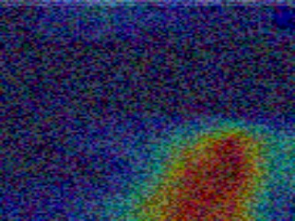
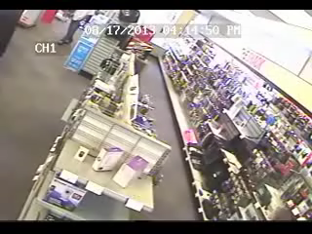
3. Output
Model’s output: Feature map
The model’s output: images/frames where there is an anomaly for sure.
It saves the image as heatmap on where to look.
Final output: The video that you can see here, is after a treatment to the output of our model. There are scripts, that we will go through later, that generates these tagged videos
Notes:
The model output: images/frames where there is an anomaly for sure.
It saves the image as heatmap on where to look.
Because apart from us, wanting to know if a Shoplifting happened, we also want to localize it well enough.
So the final output consists of a video like what you can see here, is after a treatment to the output of our model. There are scripts, that we will go through later, that generates these tagged videos.
Lets go through an example:

Slide 7
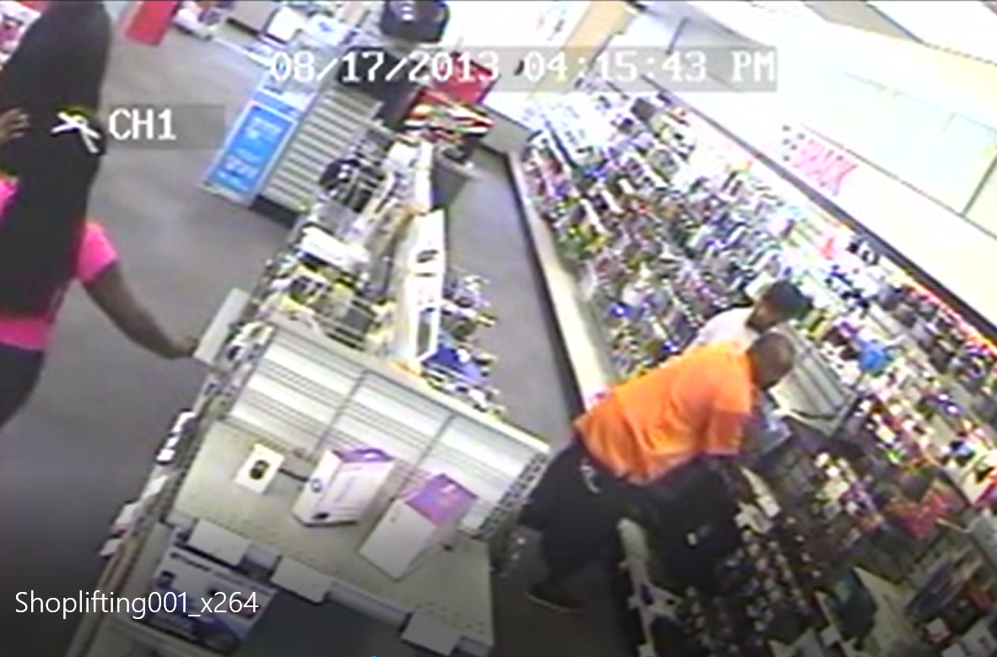
Notes:
Here, the man in orange is going to take a PC
See how our model captures this and outputs a feature map with red zone (zone of shoplifting)

Slide 8
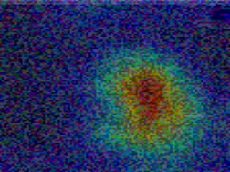
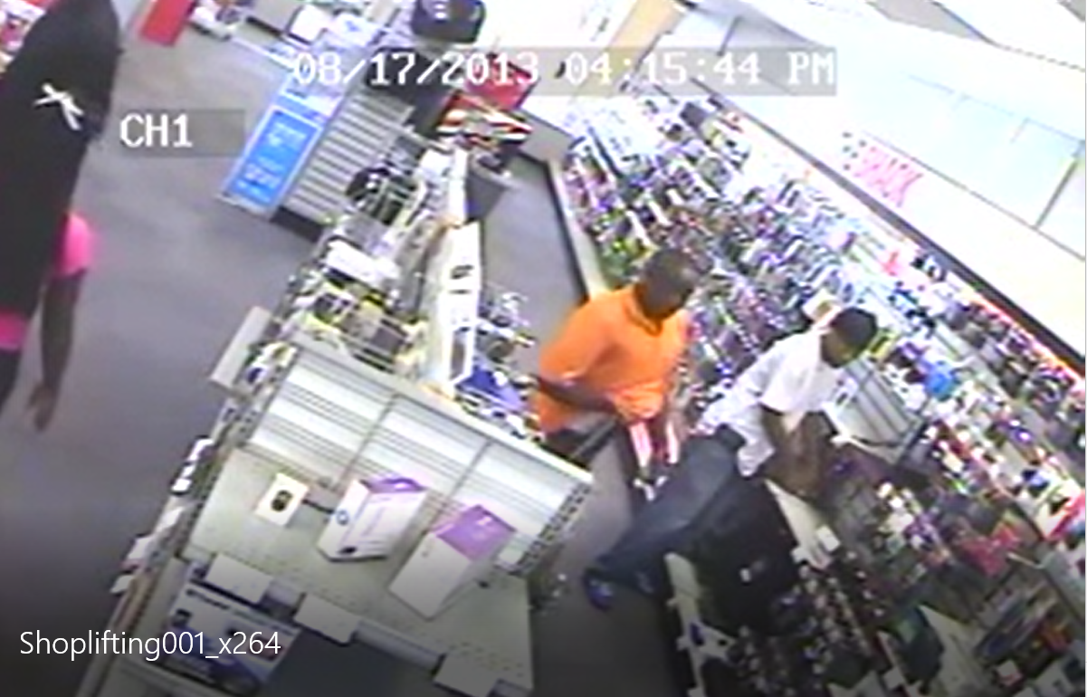

Slide 9
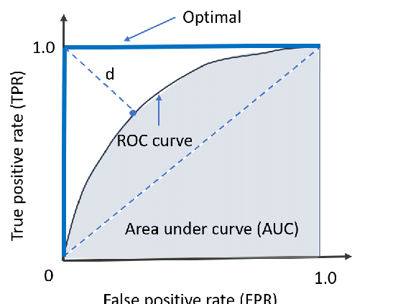
4. Model Performance
Two metrics are used:
AUC (Area Under the Curve):
78.06%
GAP (Generalization gap):
8.82%
Notes:
AUC: Area under the curve:
So, for classification, like in our case, we need to define a threshold on the output of the model that helps us classify a Shoplifting in the most accurate way. This most accurate way can be defined by maximizing the True Positives, and minimizing the False Positives. So here we have on the X axis the False Positive rate, and on Y axis, the True Positive Rate. So, the hard blue lines correspond to the optimal cases (Where we have either 0 False Positives, or 1 True Positive rate), So here in this optimal case, the area under the curve (or in this case under the hard blue lines) is 1 so 100% accurate.
Now, see that Dashed diagonal blue line, if you think about it, it corresponds to a random prediction.. So it is likely to have 50% of accuracy and Thus have a AUC of 50% too. Now, how to construct our ROC curve: we take a threshold on the decision (either normal or shoplifting) and for each value we will have a point (x,y) of (FPR and TPR). We choose all possible thresholds (probability threshold so between 0 and 1) and for each value we draw a point. Until we have that curve. We then choose the threshold that minimizes the distance between the curve and the (0,1) point. That is the optimal point. This way, we can choose the best threshold probability, that maximizes our accuracy. We then calculate the AUC and in our case we find 78% which is quite good in my opinion.
Then the second metric, is the generalization gap, which is the difference between a model's performance on training data and its performance on unseen data drawn from the same distribution.
Good values range between 1% and 30%, so we can say with enough confidence that our model generalizes well on unseen data
If ask how ? Well, at the start of the project, there is data that is selected for testing only. So the model do not know of its existence and have never seen it. Then when testing, we compare how the performance differ and we compute the metric

Slide 10
Thank you ☺

